Slide 1
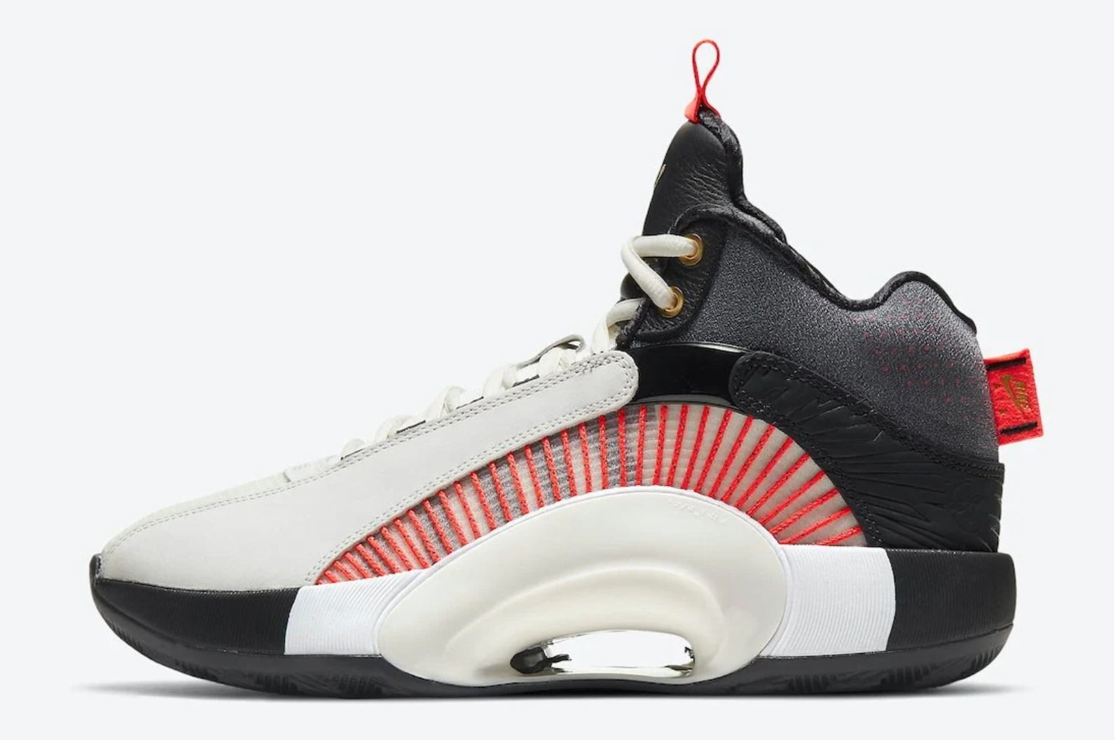
Today we will research to find newspaper and journal articles using Gale Databases.
We will also create bibliographies using EasyBib!

Slide 2
Log into Clever: www.clever.com/in/yonkers
Scroll down to Library Services and select Gale Resources.
Select Cross Search, then Power Search!
Do a keyword search! Remember to broaden your search by using the word “and”. To narrow your search, use the filters.
Remember to locate “Full Text Documents” only!

Slide 3
After you locate an article, click on Cite and export to EasyBib!
Create an EasyBib account.
Rename your project.
When you are done, “export all” to Microsoft Word.

